Slide 1
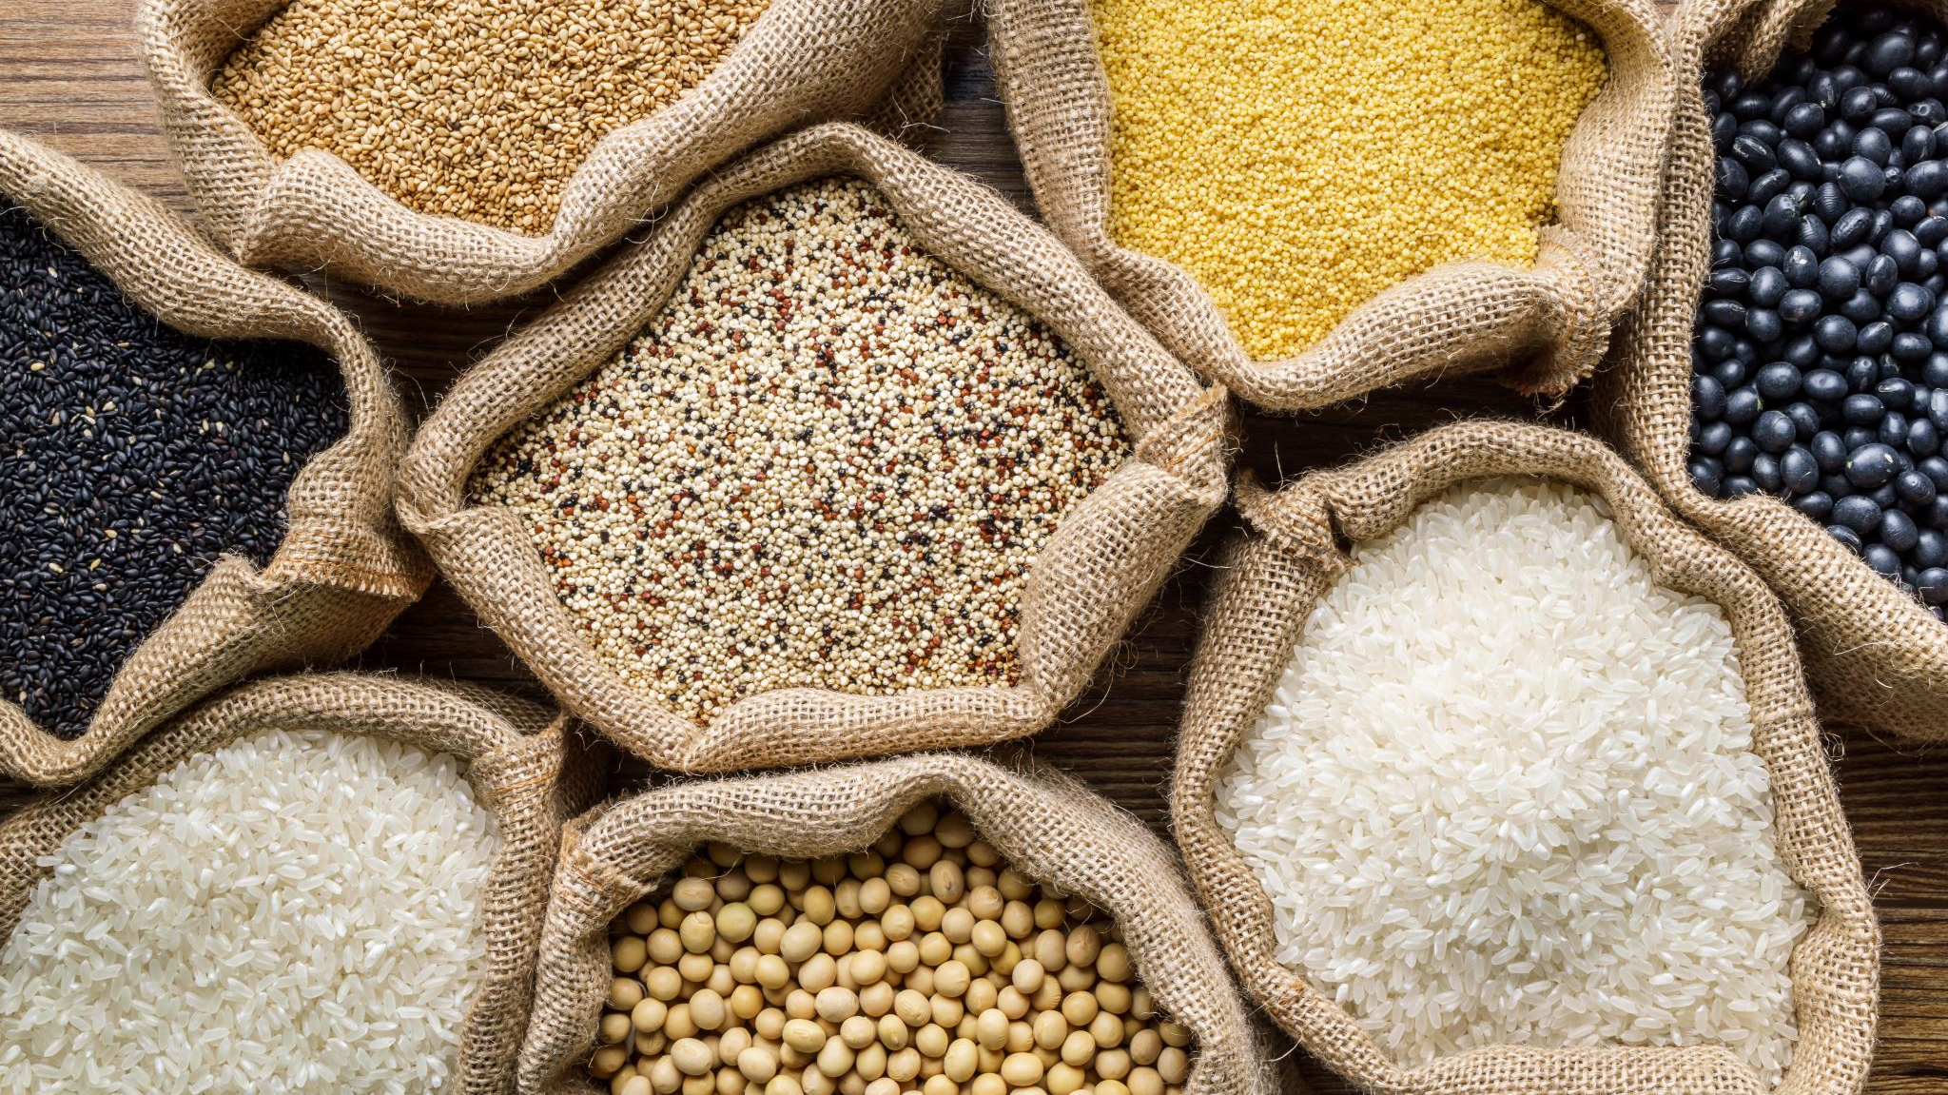
The Food- Population Nexus:
The Dawn of the Agricultural Revolution

Slide 2
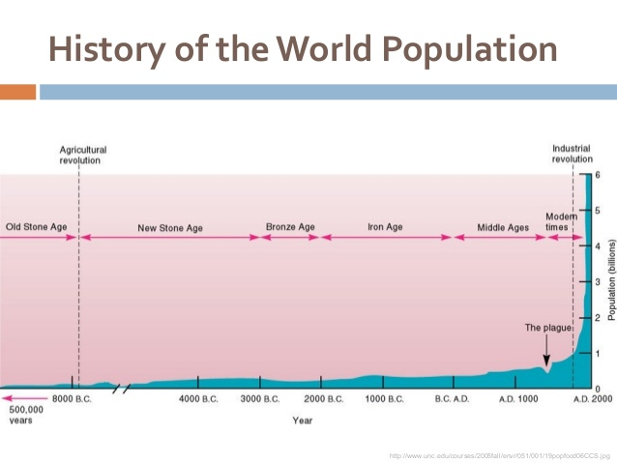
Agricultural Revolution starts 10,000 years ago
Source: http://www.slideshare.net/thelawofscience/human-population-26811774

Slide 3
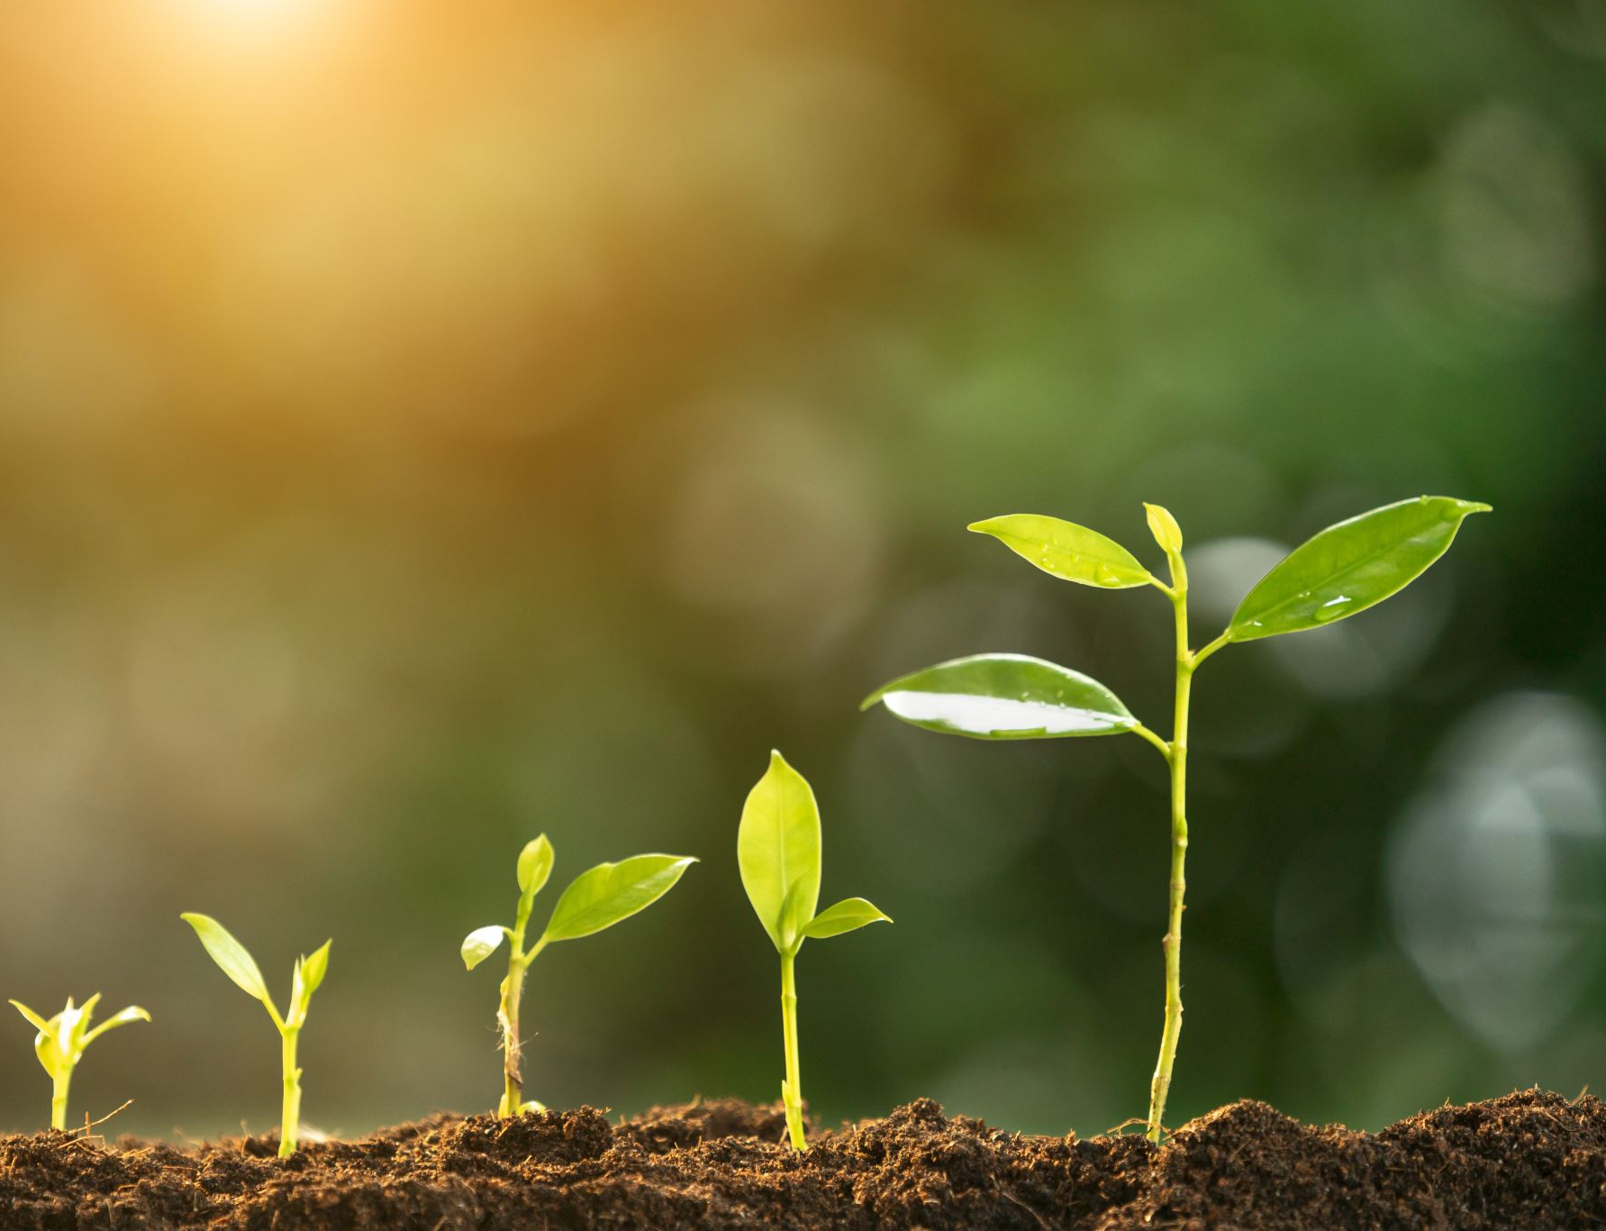
Why Did Humans Become Agricultural?
Humans did not have one eureka moment were they learned that plants grow from seeds that can be gathered and planted. Humans were planting bottle gourds seeds some twenty-thousand years before the agricultural revolution. Evidence shows that dogs, were domesticated between 18,800 and 32,100 BC. Hence domestication of animals was not the reason for the agricultural revolution.
Jared Diamond maintains that most humans suffered a severe decline in their quality of life from the shift to agriculture. This decline in the quality of life makes it even harder to understand why humans suddenly become agricultural.
Be sure to read the Jared Diamond article before continuing with the video

Slide 4
Some of the Benefits of being a Hunter-Gatherer
High level of equality between genders and all people.
Lots of leisure time.
Healthier life
Longer life expectancy
Less likely to die of starvation

Slide 5
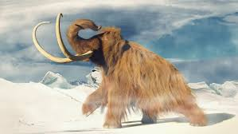
Side Note: Hunter-Gatherers did Seem to cause the Extinction of many Large Animals
Why did most of the large mega-fauna disappear from places like Eurasia, North and South America and Australia?
Climate Change vs- Human Hunters Debate
For more information see and David Burney and Timothy Flannery http://www.micro.utexas.edu/courses/THOC/Readings/Burney_Flannery2006.pdf

Slide 6
Disadvantages of Pre-industrial Agricutlure
1) Higher risk because one is more dependent on fewer species. Failure of a major crop or disease among an animal species can result in famine.
2) Involves a lot more labor than hunting and gathering.
3) Promotes rise of social inequality
4) Women become subordinate
5) Emergence of most of our diseases
6) Despotism
6) Long term decline in health and life expectancy.

Slide 7
Agricultural Revolution: Downsides of dietary changes
Less nutritious/less immune system friendly than hunter-gatherer diet
More prone to famine
Zoonosis- diseases that jumped from animal to human populations. (Diseases introduced from domesticated animals or unwelcomed guests (mice and rats) after our stored food.)
Implications for population growth

Slide 8
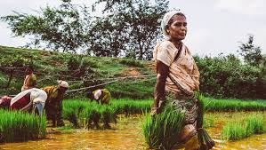
What is the Advantage of Agriculture?
Agriculture can generate a lot more food per acre than hunting and gathering.

Slide 9
Amenorrhea and Birth Spacing in Hunter-Gathers
Weight appears to be the primary factor of determining the age of first menarche.
For the average female (5’5” – 5’6”) body fat during this spurt goes from 5.1 to 11.5 kilos or from 11.2% to 25.30%.
As women get older the body fat ratio must increase slightly to maintain a regular ovulatory cycle.
Average woman has a 28% body fat ratio
The average male has 12-14% body fat ratio
This difference between men and women equals the energy that is needed to complete a pregnancy and three months of lactation.
Reproduction requires energy 50,000-60,000 calories to produce a viable infant and close to 1,000 a day for lactation. This is in addition to one’s daily caloric requirements to maintain other life processes.

Slide 10
How Agriculture Increased the Rate of Human Population Growth
Birth rates climb in agricultural societies because of the shift in the balance of their diet towards carbohydrates
Hunter-gathers constrained by diet- nutritional amenorrhea –bodies don’t acquire necessary body-fat ratio until much later in their teens.
Delays age of first reproduction
Increase birth spacing-breastfeeding consumes lots of calories so this will keep the body fat ratio of hunter-gather women very low.
Lactational Amenorrhea –breastfeeding at regular intervals (LAM method of contraception)
Hunter-gatherer women breastfeed their children longer and because they keep their children with them, they are able to feed their children at more regular intervals.
For people more interested in this topic, I recommend reading about the Frisch-Revelle Hypothesis: Frisch RE, Revelle R. The height and weight of girls and boys at the time of initiation of the adolescent growth spurt in height and weight and the relationship to menarche. Hum Biol. 1971 Feb;43(1):140-59.

Slide 11
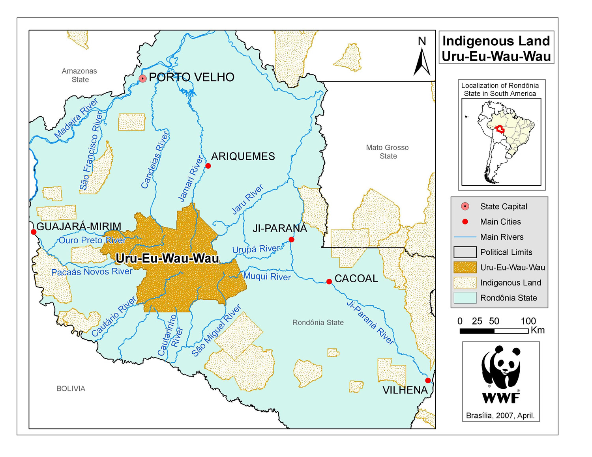
Uru Eu Wau Wau – An Example of a Group in Transition from Hunting and Gathering to Agriculture?

Slide 12
Agriculture as a Slippery Slope That Leads Humans Towards Dependency.
Crops can help supplement a food supply but it that it increases the amount of carbs in diets, it also increases fertility and over time the reliance on agriculture will grow.
As crops become more important humans can no longer afford to abandon them and some humans must give up being hunter-gathers and protect the crops from animals and other humans.

Slide 13
Explanations for the Agricultural Revolution
Population pressure often forces humans to employ existing agricultural knowledge (Esther Boserup)
Climate change: Evidence that agriculture did not arise anywhere until after the last Ice Age. There is a warmer, wetter, more stable climate in Holocene.
Changing availability of food—reduction in big game;
Agriculture would have improved predictability of food supply
Religious codes (religion helps create structures and rules that help people live together and decreases violence within a group) Reduction in male-male violence is necessary. However, agriculture is generally believed to lead to an increase in the violence and the intensity of that violence between groups.
Farming as status symbol that makes farmers feel superior to hunter-gatherers

Slide 14
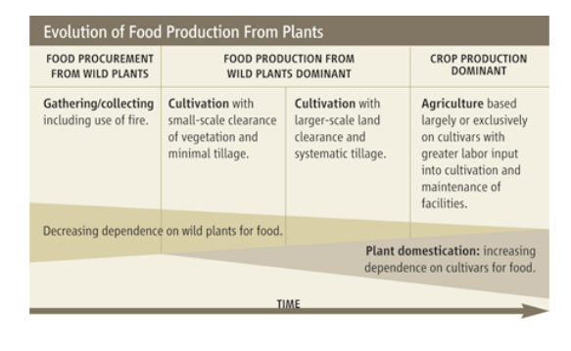
Revolution Vs. Evolution- Evolution is a more Accurate Term because this was not a Rapid Process
Increasing population growth rates help push things along.
Source: https://www.amherst.edu/system/files/media/0424/Origin%2520agriculture.pdf

Slide 15
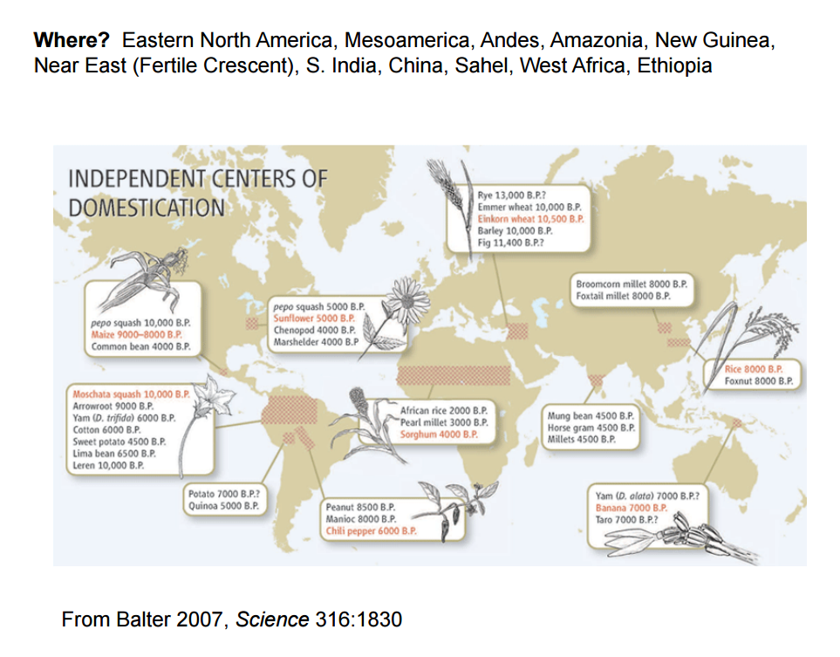
Centers of Crop Domestication
Source: https://www.amherst.edu/system/files/media/0424/Origin%2520agriculture.pdf

Slide 16
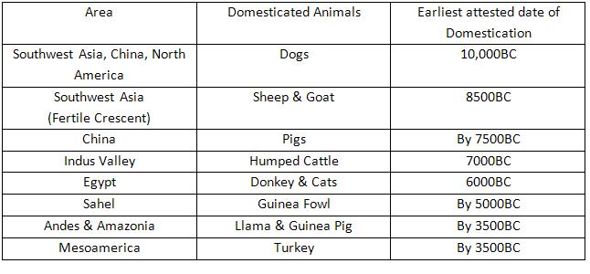
Origins of Some of our Animal Domesticates
*Note that the number given for the dog is just to suggest that dog was already present at the start of the Agricultural Revolution. The dog was domesticated eight to twenty thousand years earlier.
Source: http://twcg6livestockproduction.weebly.com/how-were-animals-chosen-for-domestication--why-so-few-domesticated.html

Slide 17
Early Agriculture was Extensive in Nature
This mean that if a group wanted to produce more food it did so my extending the amount of land they controlled. This helped create violent conflict in which the winner would seize territory.
The two main types of extensive agriculture are pastoralism and swidden ( involves some form of crop rotation,) Depending on the geography is can involve plowing, slash and burn and, in rare cases, slash and mulch.

Slide 18
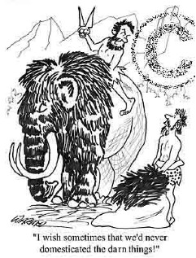
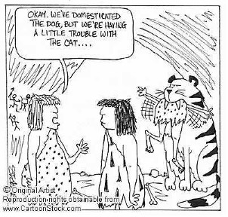
Not all our attempts at Domestication succeeded

Slide 19

Questions for Next Class
Is food production still the main driver of the human population?
Thomas Malthus believed that a sort of carrying capacity for human exists and at some level the amount of food we can produce will determine that carrying capacity. Do you agree with Malthus? Why or why not?( Note- Malthus never used the term carrying capacity but the concept is implicit in his arguments.

